Slide 1
NYPD Arrest Data Analysis
Presented by
MOUHAMED MAREGA

Slide 2
Project analysis slide 2
Agenda
Tools used for the analysis
Let’s answer some question
NYPD Arrest Data
Introduction
Conclusion
Explore the data
Recommendation

Slide 3
Tools used for the Analysis
Python - Google Colab
OpenData – Source of the NYPD_Arrest_Data
NYC.gov website – To learn about the mission of NYPD is New York City. (https://www.nyc.gov/site/nypd/news/p00084/nypd-citywide-crime-statistics-june-2023)

Slide 4
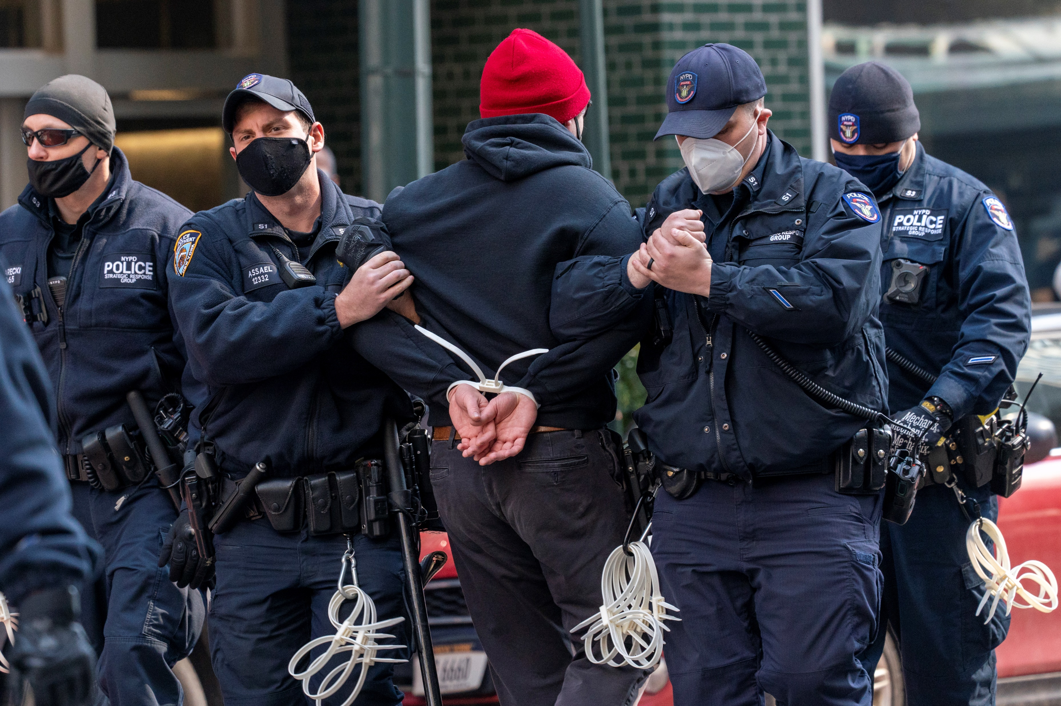
Project analysis slide 3
Introduction
NYPD is the New York Police Department.
NYPD’s mission is to enhance the quality of life in New York City by working in partnership with the community to enforce the law, preserve peace, protect the people, reduce fear, and maintain order.

Slide 5
Project analysis slide 5
Explore the Data
NYC OpenData - NYPD Arrest Data (Year to Date) | NYC Open Data (cityofnewyork.us)
https://data.cityofnewyork.us/Public-Safety/NYPD-Arrest-Data-Year-to-Date-/uip8-fykc
This dataset contains in total 112,571 rows, where each row represents an “Arrest” or “Offense”.
It also contains 24 columns, where each column represents a descriptive entity for the data.
In this data, there are only arrests that occurred in this year. Meaning from January 2023 to June 2023. (It was last updated on July 14th, 2023)

Slide 6
Project analysis slide 6
Analysis
Let’s answer some questions

Slide 7
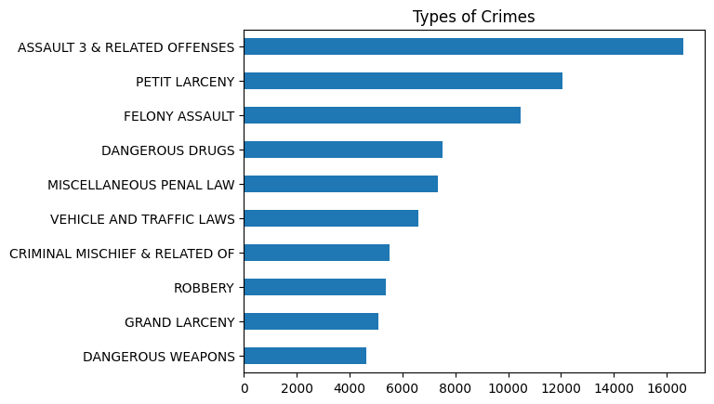
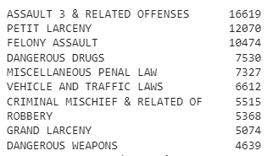
Project analysis slide 7
What are the most common Arrest made
in terms of offense group?
These are the top 10 offense groups with the most arrest:

Slide 8
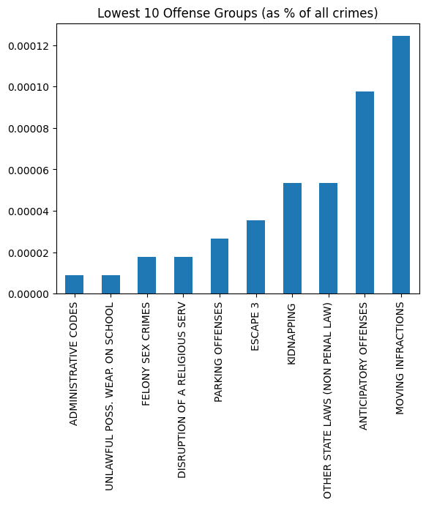
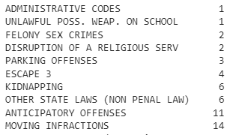
Project analysis slide 7
What are the Least common Arrest made
in terms of offense group?
These are the 10 offense groups with the lowest arrest made:

Slide 9
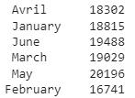
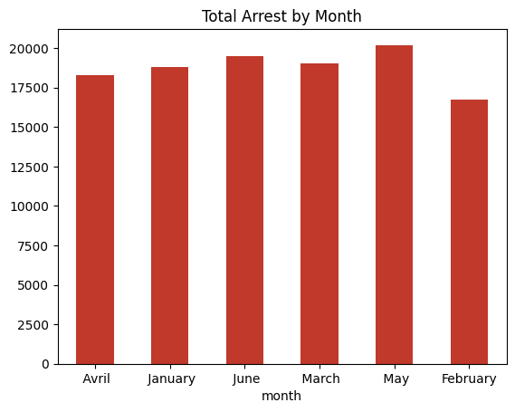
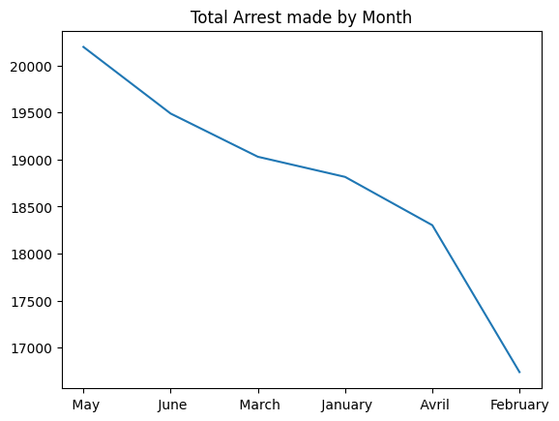
Project analysis slide 7
Total Arrest made by Month
. February was the month with the lowest arrests made with 16741 arrests, where the month of May was the month with the highest arrests occurred with 18302 arrests

Slide 10
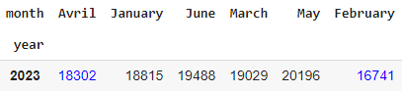
Project analysis slide 7
How many arrest has occurred on average
throughout the year 2023 so far?
The average number of arrest made in 2023 so far is 18761.83.
which months were the number of crimes below average?
Highlight those below average in BLUE.

Slide 11
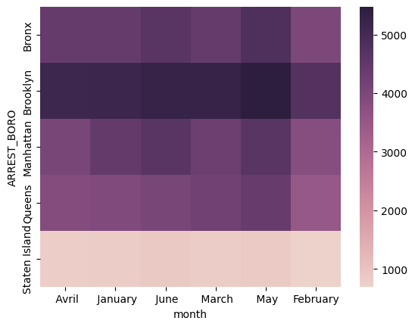
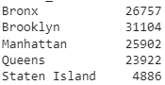
Project analysis slide 7
How many arrest has been made
in each borough in NYC so far in 2023?
Number of arrest made in each borough in NYC from January 2023 to June 2023

Slide 12
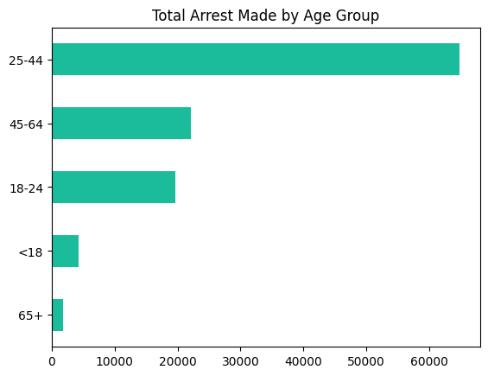
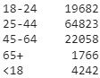
Project analysis slide 7
What is the age group with
the highest arrest in NYC?
The age group with the highest arrest in NYC from January 2023 to June 2023:

Slide 13
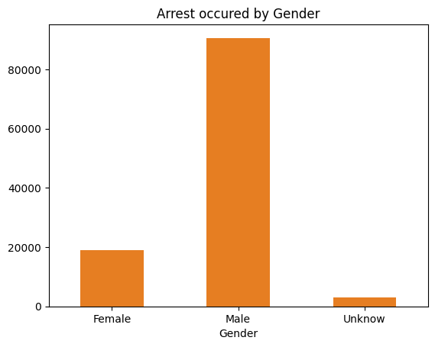
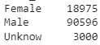
Project analysis slide 7
Which gender is most likely
to be arrested in NYC?
Arrests occurred by gender from January 2023 to June 2023

Slide 14
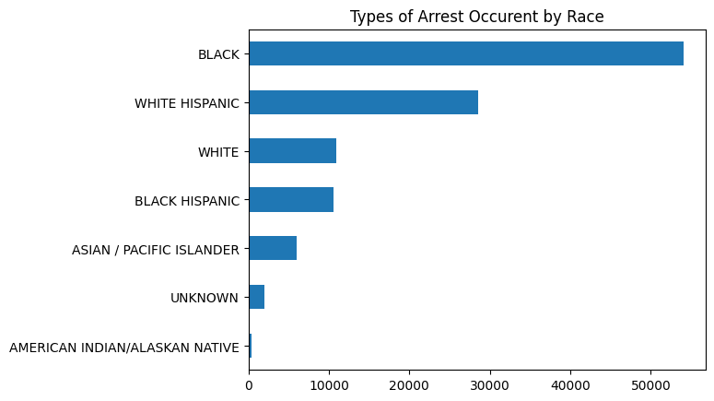
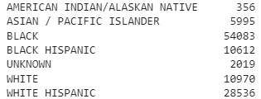
Project analysis slide 7
Which race is most likely
to be arrested in NYC?
Arrests occurred by race from January 2023 to June 2023

Slide 15
Project analysis slide 8
Conclusion
INSIGHT
By using Python as data analytics tool and his libraries such as Pandas, NumPy, Matplotlib and Seaborn, I was able to analyzed and visualized the open data of NYPD arrests data of 2023 (from January to June).
Through my analysis, I have found the following insight:
The most common arrest made by NYPD in 2023 so far is “Assault in 3rd degree with over 16,000 arrests made.
The month of May 2023, was the month with the highest arrests occurred. Over 18,302 arrests made.
Brooklyn has the highest arrests made in 2023 so far, with 31104 arrest made.
The age group that most likely to be arrested is from the 25 to 44.
Males are most likely to be arrested
And lastly the Black race is more likely to be arrested with over 54,083 arrests made in 2023 so far.

Slide 16
Project analysis slide 8
Recommendation
I recommend NYPD to think about implementing strategies that allows them to identify what are the main causes for these high arrests.
Being involve with communities, participating in local community board meetings will help understand their needs and priorities.
It is very crucial for NYPD to keep an eye into their Data analysis, to spot on any changes that may occur time to time and to better help them strategically to lower crimes in NYC.

Slide 17
Thank You
Presented by:
Mouhamed Marega

